Slide 1
Covid 19 – tableau analysis
Aniket Gupta
3009300
griffith college

Slide 2
introduction
The variables represent the COVID cases registered in various countries/regions and the province of COVID-19 occurrence.
They represent the cases confirmed in these countries, the cases that have recovered from COVID 19.
It also shows the number of COVID deaths that have occurred in the different countries.
They provide a comprehensive overview of the COVID 19 cases registered.
Notes:
The variables represent the COVID cases registered in various countries/regions and the province of COVID-19 occurrence. They represent the cases confirmed in these countries, the cases that have recovered from COVID 19. It also shows the number of COVID deaths that have occurred in the different countries. They provide a comprehensive overview of the COVID 19 cases registered.

Slide 3
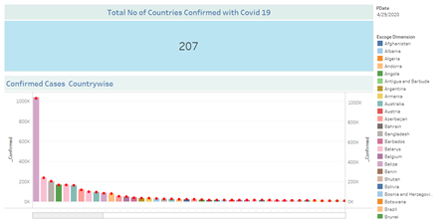
DashboArd 1
Notes:
The dashboard depicts the total number of COVID 19 cases registered in different countries. It portrays the COVID 19 confirmed cases by country. The benefit from the above dashboard to decision making process is that global healthcare organizations can focus on supporting the countries with higher COVID cases registered. Also, it will help to decide the funding to be provided for each country according to criticality of the situation. .

Slide 4
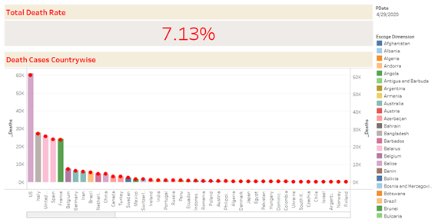
Dashboard 2
Notes:
The dashboard depicts the total death rate from COVID 19 registered in various countries. It shows the number of deaths that have occurred in each country represented during the respective time period. The decision making process can be benefitted from the dashboard by assessing and learning about the highest incidence of COVID and providing help to these countries in the order.

Slide 5
Dashboard 2
Notes:
The dashboard depicts the total death rate from COVID 19 registered in various countries. It shows the number of deaths that have occurred in each country represented during the respective time period. The decision making process can be benefitted from the dashboard by assessing and learning about the highest incidence of COVID and providing help to these countries in the order.

Slide 6
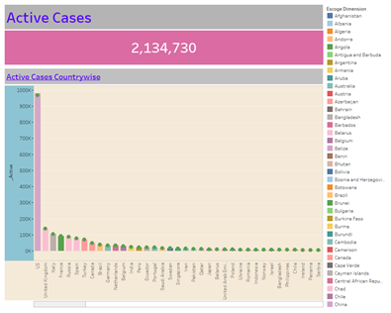
Dashboard 3
Notes:
The dashboard shows the current active cases of COVID in different countries of the world. It is a key dashboard as it presents the detail of COVID cases that are confirmed and are currently in treatment. The decision making process will be highly benefitted if the countries with highest number of deaths assess and utilize prevention methods of countries with no COVID deaths. They can also benefit from providing support to these countries based on the severity in terms of death.

Slide 7
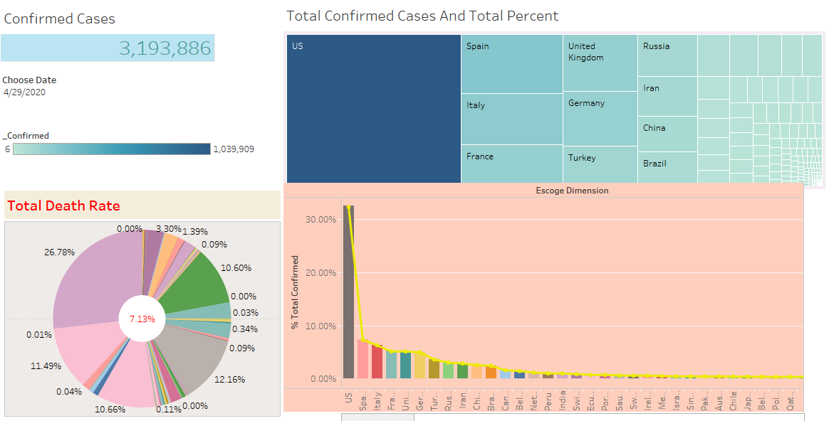
Dashboard 4
Notes:
The dashboard represents the number of total confirmed cases globally. It also depicts the total death rate in percentage for different countries. Mosaic plot shows occurrence in the countries mainly depicting the highest incidences of confirmed cases. Also the total confirmed cases are shows in column chart as percentage for the different countries. The decision making process is supported with the dashboards with benefit of learning about severity of confirmed cases and the largest number of cases. It will also support the healthcare organizations to offer support and provisions to reduce the cases. Also, the government of respective country will be able to understand about the case of the COVID 19 and undertake immediate emergency procedures during pandemic.

Slide 8
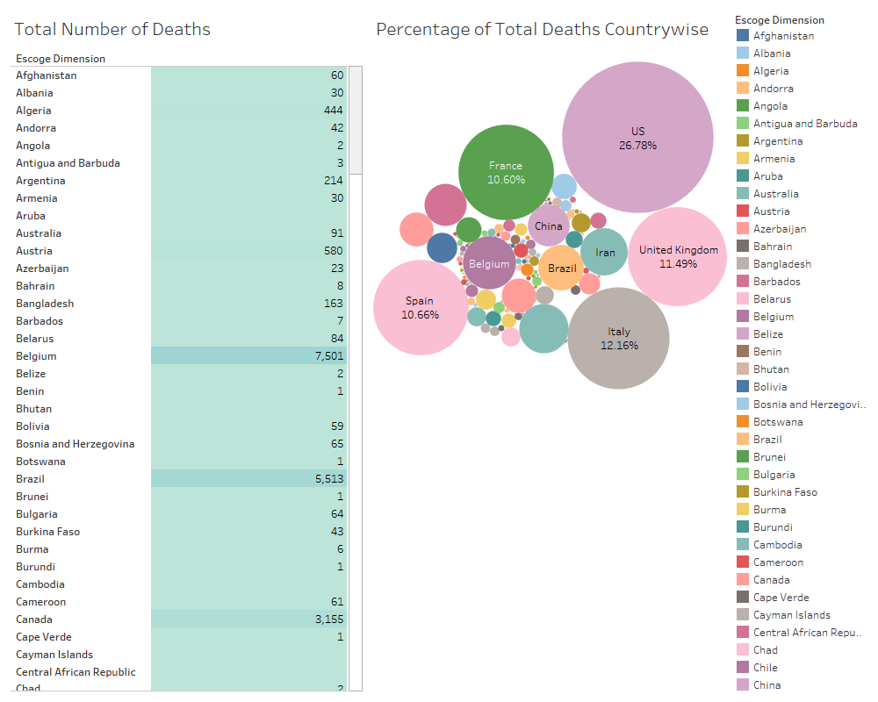
Dashboard 5
Notes:
The dashboard represents the bubble chart with cluster of circles showing prevalence of COVID deaths. The table shows the total deaths with the chosen dimension as country-wise representation. The dashboard is used for decision making process to provision of support the pandemic. This can be used for making neighboring countries to take precautions, and make beneficial decision about offering support in time of the crisis. Also, the countries will find it beneficial to make decisions regarding business relations, imports, and exports etc.

Slide 9
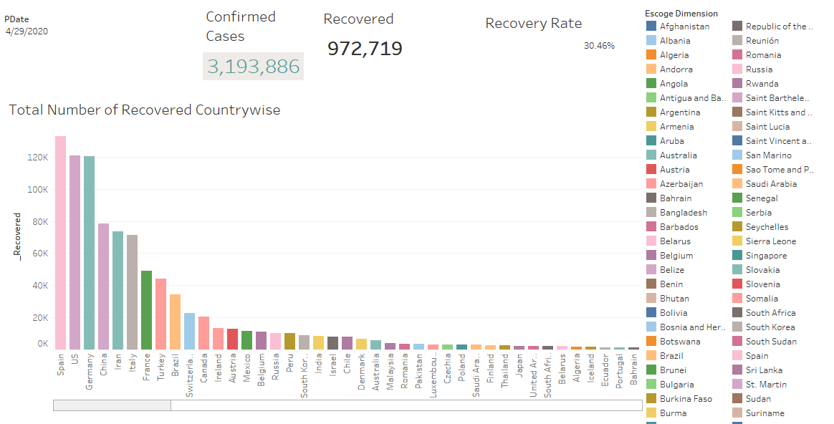
Dashboard 6
Notes:
The dashboard depicts the total confirmed cases around the world and the cases recovered globally. It also depicts the recovery rate globally and the number of cases that have totally recovered till date. The decision making process can be benefitted by using the date to observe the recovery rate from the dashboard with other dashboards relative to the confirmed cases and deaths in each country. It can be used to assess rate of response of the governments to the COVID pandemic.

Slide 10
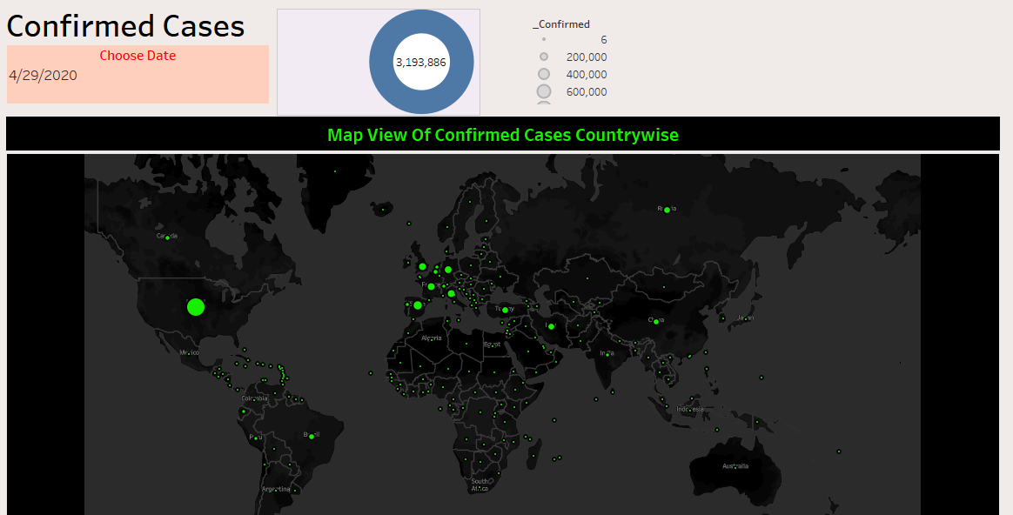
Dashboard 7
Notes:
The dashboard is a map view of the confirmed COVID 19 cases. It is a representation of the intensity of COVID in each country shown with the map. The decision making process can be beneficial using the dashboard as the country officials can use it to assess their neighboring countries and take precautionary measures. They can be aware of incidences around their neighbors and the relative impact on their country as well as for offering support.

Slide 11
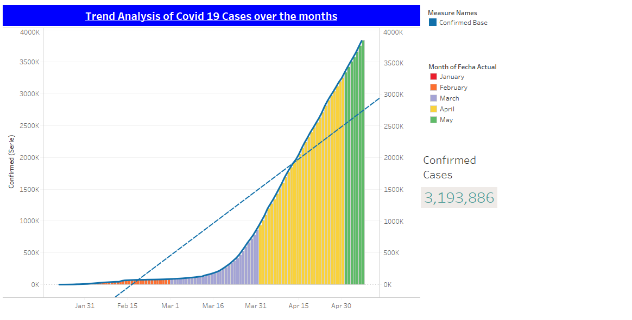
Dashboard 8
Notes:
The dashboard represents the trend analysis of the COVID cases for the months January through May. It also shows the trend line plotted with the data for different months on global COVID cases. The decision making process is benefitted from using the dashboard is that global governments should strive to fight the pandemic. The trend shows that it is important for countries to not merely treat the patient but also initiate lockdown procedures to prevent movement in and out of the country. Also, it should be used for initiating research to find the appropriate cure for the disease.

Slide 12
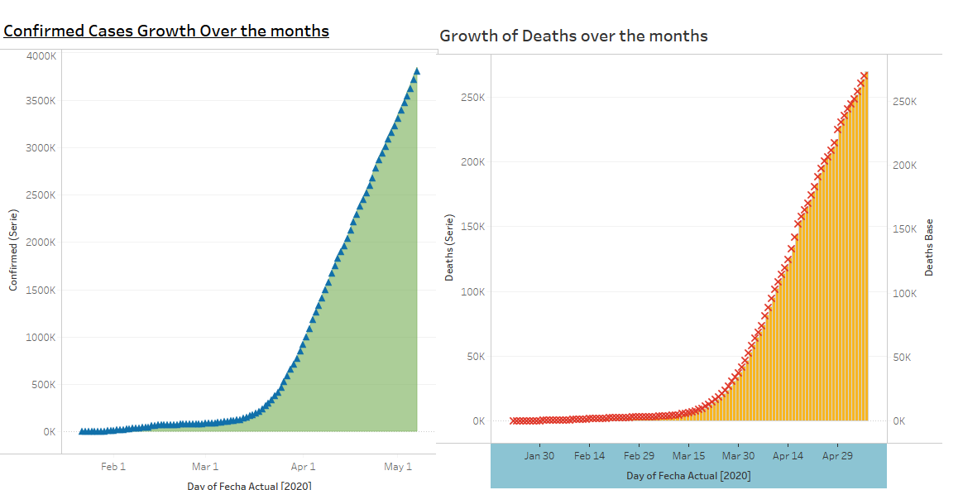
Dashboard 9
Notes:
The dashboard shows the growth of confirmed COVID cases and the COVID deaths globally. The two can be compared to make a comprehensive comparison of the growth rate of confirmed cases and the deaths that have occurred during the period. The benefit of the dashboard to make decision is that it can be used for learning the increase in the COVID cases confirmed globally and take the preventive measures in all countries by the respective the government authorities. This will help to prevent the incidence in other countries.

Slide 13
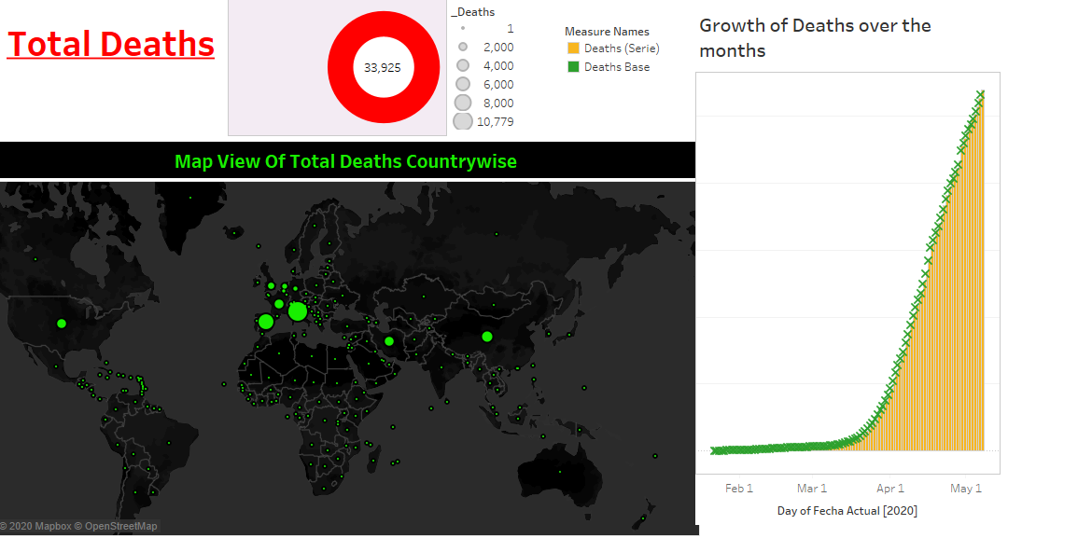
Dashboard 10
Notes:
The dashboard shows the total death rates globally in world map. It also shows the growth of COVID related deaths during January 22 to May 6. It benefits the decision making process by depicting the highest cases of the deaths occurred globally in different countries. The benefits are derived by the countries that use the dashboard to learn about the high death rates and secure interactions as well as offer support to these countries.

Slide 14
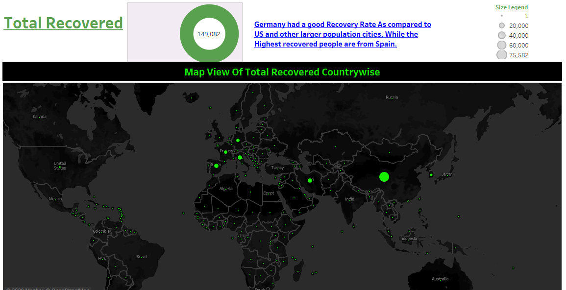
Dashboard 11
Notes:
The dashboard shows map view of the total cases that have recovered from COVID 19 globally. It is represented in the world map on the cases that have recovered globally in different countries. The benefits of the dashboard to decision making process are that it will support the global governments to interpret the clinical intervention used for treating the patients and increasing recovery rates.

Slide 15
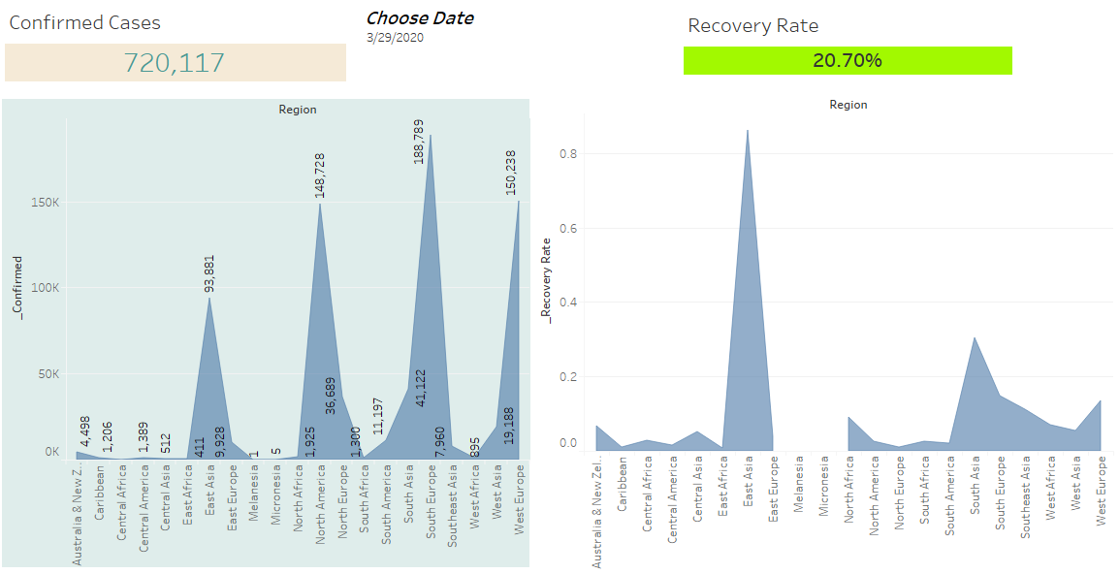
Dashboard 12
Notes:
The dashboard shows confirmed cases comparison compared with the recovered cases for each continents. It is shown with relevant legends represented with climber line chart type. It is beneficial to make decisions on supporting different continents and evaluating adequate preparedness of the continents against such global contingencies.

Slide 16
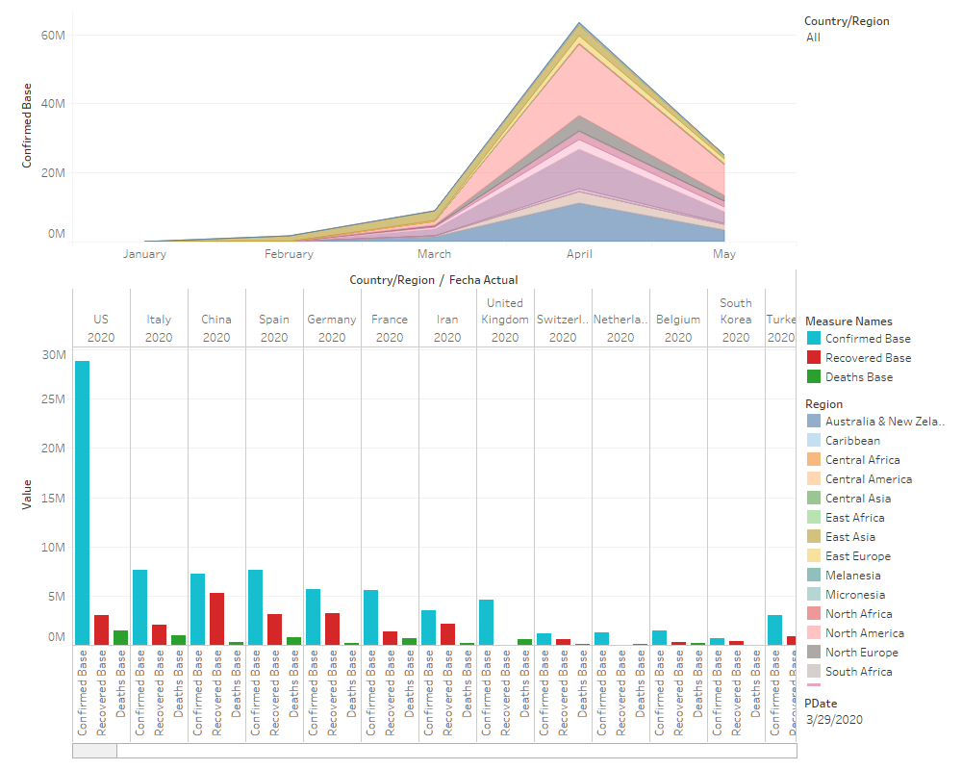
Dashboard 13
Notes:
The dashboard shows the area chart of different countries and the confirmed cases in the region. It also shows the comparative visualization of COVID confirmed cases, recovered cases, and deaths. The benefits of the dashboard to decision making process is that the dashboard can be used for making meaningful assessment about how the countries have fought the COVID crisis with a relative comparison of the confirmed cases, recoveries as well as deaths.

Slide 17
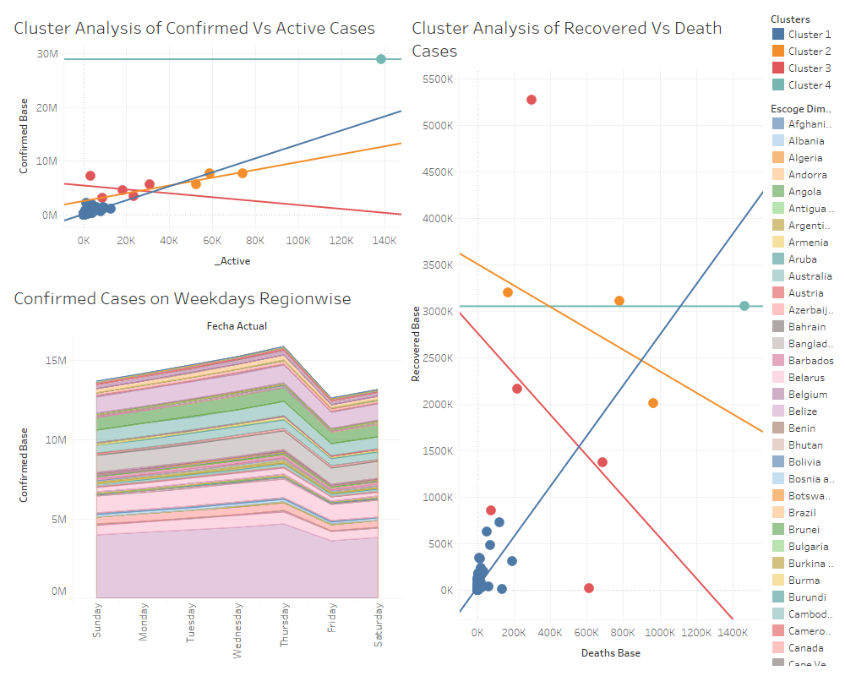
Dashboard 14
Notes:
The dashboard shows cluster analysis between confirmed cases and cases that are still active (confirmed less recovered less deaths). It also shows weekdays confirmed cases regionwise. The dashboard also performs cluster analysis between recovered COVID cases and the related deaths. It is beneficial to decision making process for identifying countries with highest COVID spread from the clusters of confirmed cases. Also, it is used to learn about the cluster of countries that successfully recovered from the COVID pandemic.

Slide 18
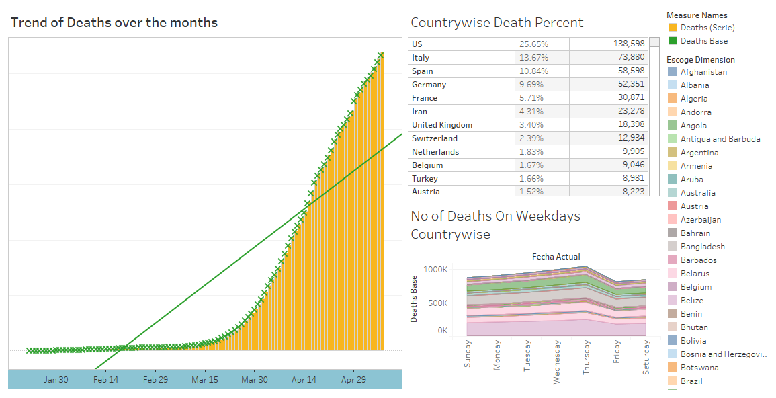
Dashboard 15
Notes:
The dashboard shows country wise death percentage along with number of deaths that occurred during week days. Also, the dashboard shows trend of COVID deaths during the period of January 2nd to May 6th, 2020. It is beneficial to healthcare decision making process regarding adoption of new clinical intervention for treating the COVID patients in country with highest death incidence. Also, countries with low death rates can transform their proposed clinical interventions as adequate treatment intervention after proper medical research.

Slide 19
References;
Kaggle. (2020). COVID-19 Case Study - Analysis, Viz & Comparisons. Retrieved from https://www.kaggle.com/tarunkr/covid-19-case-study-analysis-viz-comparisons/data

